Slide 1
Flip Image Using Python
Imanuel Ronaldo / 2103161044

Slide 2
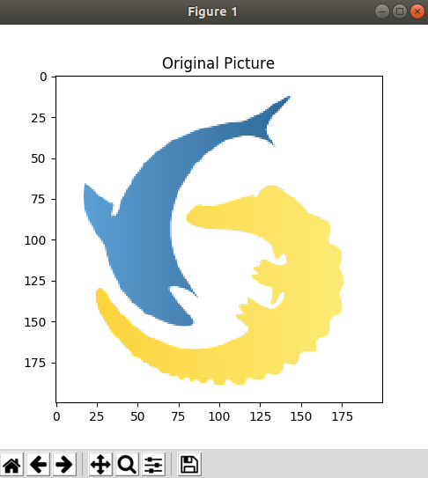
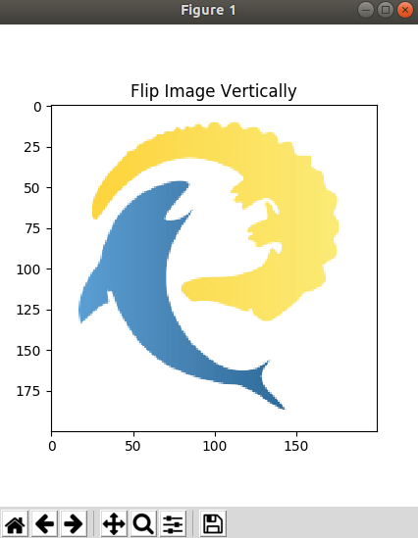
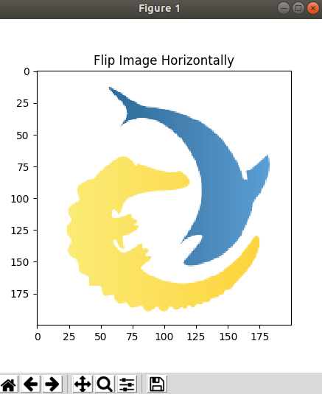
import numpy as np
import matplotlib.pyplot as plt
import imageio
img = imageio.imread("surabayapy.jpg")
img_height = img.shape[0]
img_width = img.shape[1]
img_channel = img.shape[2]
img_type = img.dtype
img_flip_horizontal = np.zeros(img.shape, img_type)
img_flip_vertical = np.zeros(img.shape, img_type)
#flip image horizontally
for y in range(0, img_height):
for x in range(0, img_width):
for c in range(0, img_channel):
img_flip_horizontal[y][x][c] = img[y][img_width-1-x][c]
#flip image vertically
for y in range(0, img_height):
for x in range(0, img_width):
for c in range(0, img_channel):
img_flip_vertical[y][x][c] = img[img_width-1-y][x][c]
plt.imshow(img)
plt.title("Original Picture")
plt.show()
plt.imshow(img_flip_horizontal)
plt.title("Flip Image Horizontally")
plt.show()
plt.imshow(img_flip_vertical)
plt.title("Flip Image Vertically")
plt.show()

